Slide 1
PHI 600 Scientific Research Methodologies

Slide 2
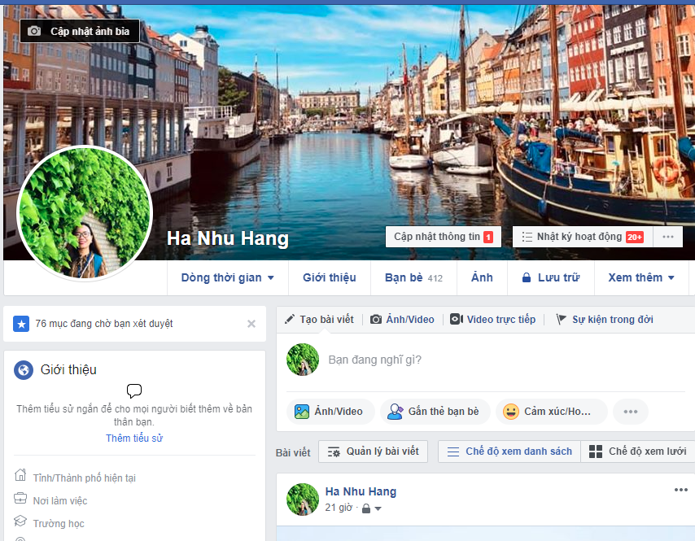
About me
HA THI NHU HANG – Tiffany
Email: hatnhuhang@duytan.edu.vn
Phone: 0968.191.677

Slide 3
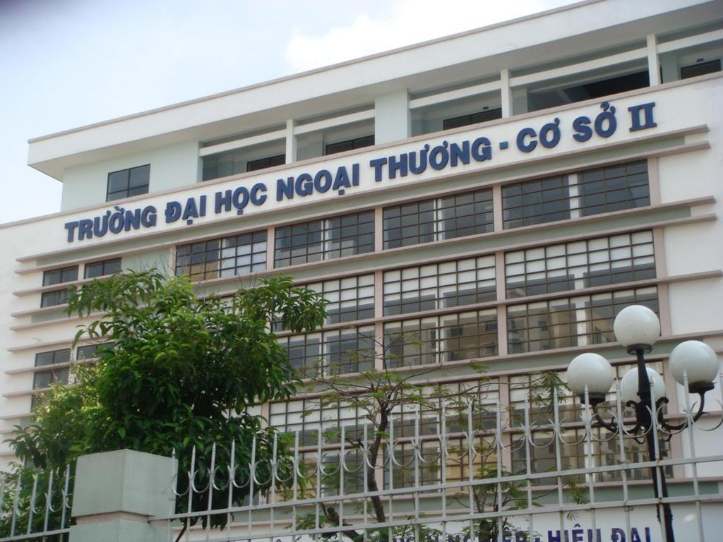
Foreign Trade University
International Business (2000)

Slide 4
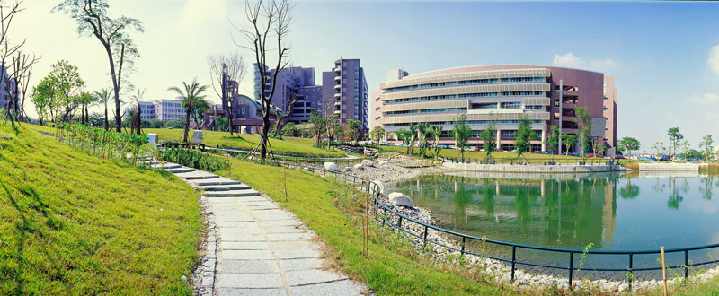
Shu-Te University – Taiwan (2007)
Management Information System
Work and study program

Slide 5
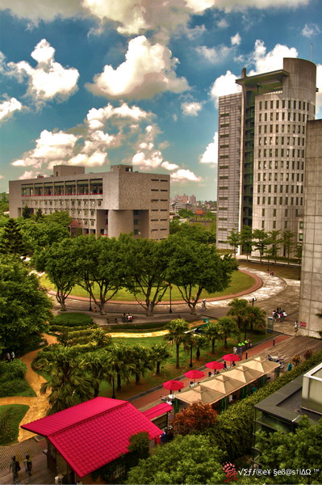
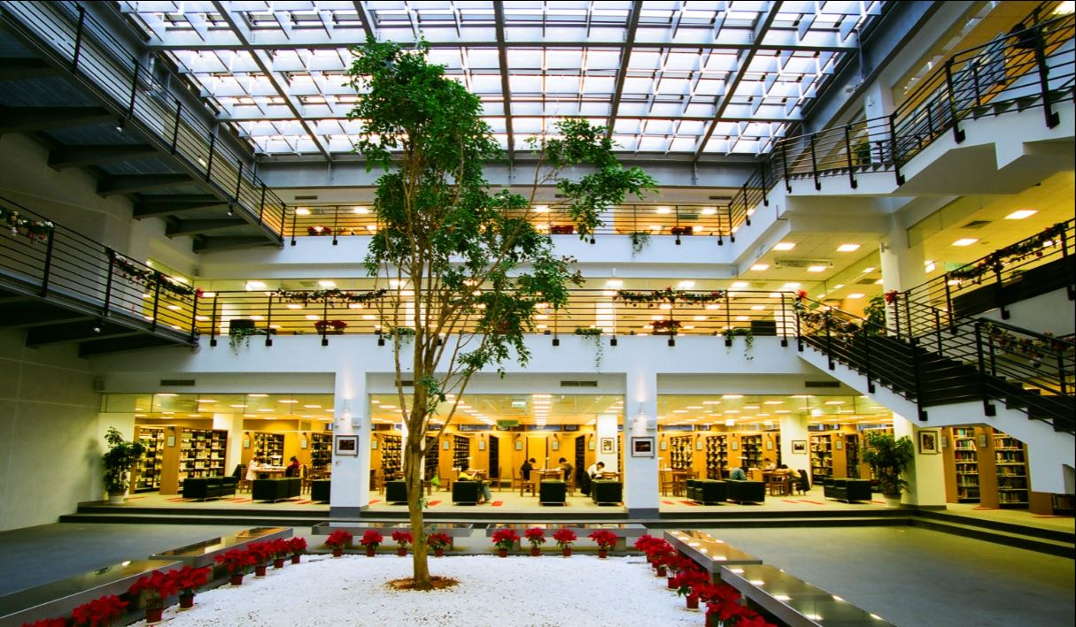
Yuan Ze University – Taiwan (2011)
Information Management
Ichef – POS
Arwin – Cosmetic
KMS

Slide 6
Working experience
VJCC – JICA
(SMEs projects)
Siquar Hardware Ltd.,
(LED, hardware projects)
Le & Associate
(HR – Head hunter)
2004
2005
2007
2016
Foreign Trade University
Shu-Te University
Yuan ZE University
DTU
Graduate School
Institute of R&D
International School

Slide 7
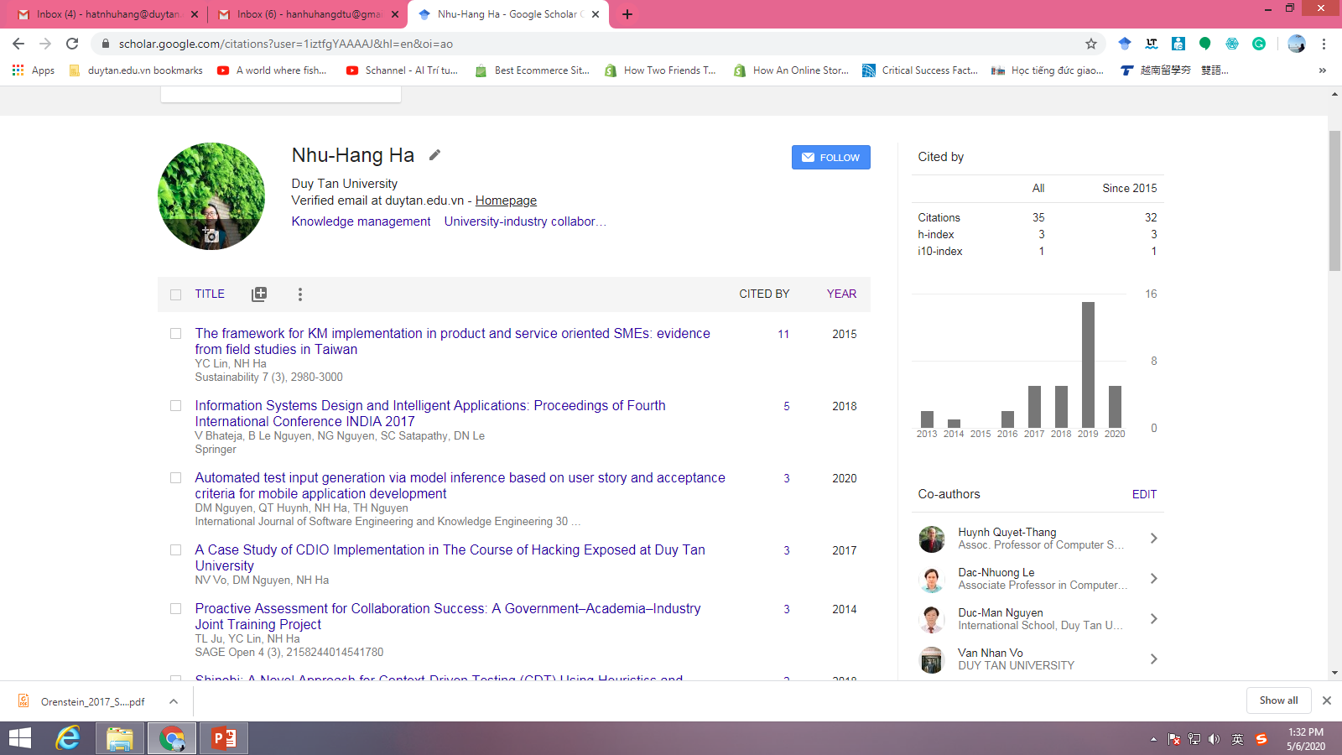

Slide 8
Research Methodology
Write up thesis
Write up papers
…

Slide 9
Evaluation
Content | %
Attendance | 10% (part 1)
Practical application | 20% (part 2 +3)
Midterm | 15% (part 4)
Final Exam - Report | 55% (part 5 +6)

Slide 10
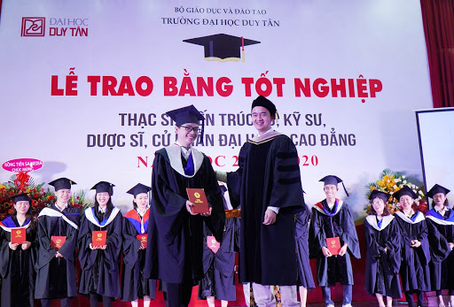
Your goal

Slide 11
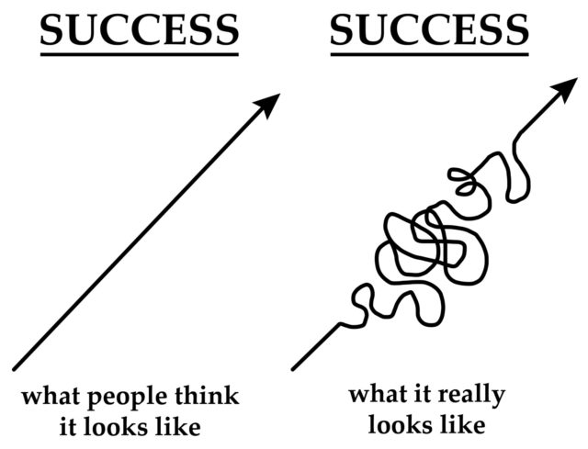
Your goal

Slide 12
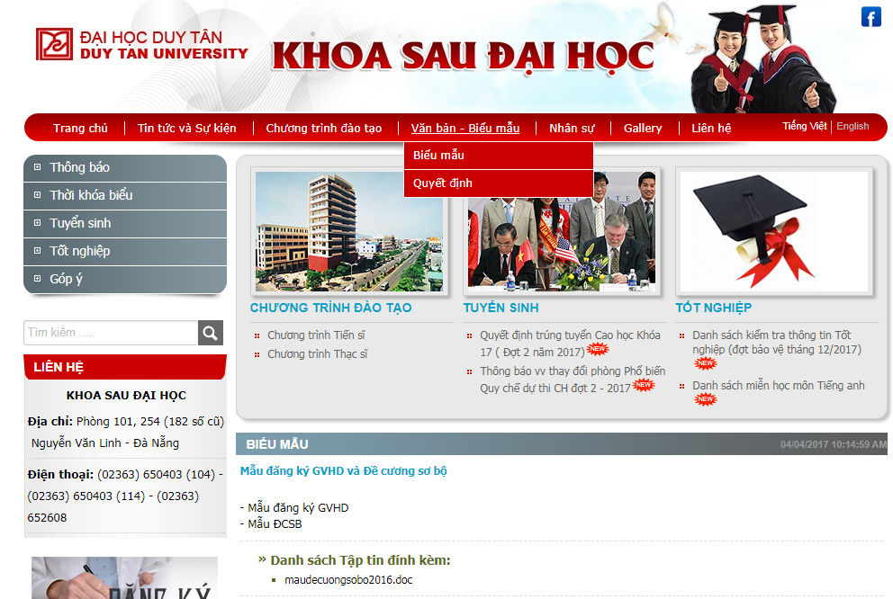
Forms - Procedures
http://sdh.duytan.edu.vn/

Slide 13
Forms - Procedures
Register Topic, Advisor
Proposal defense
Thesis Defense
Finish courses
Take English B1 Exam

Slide 14
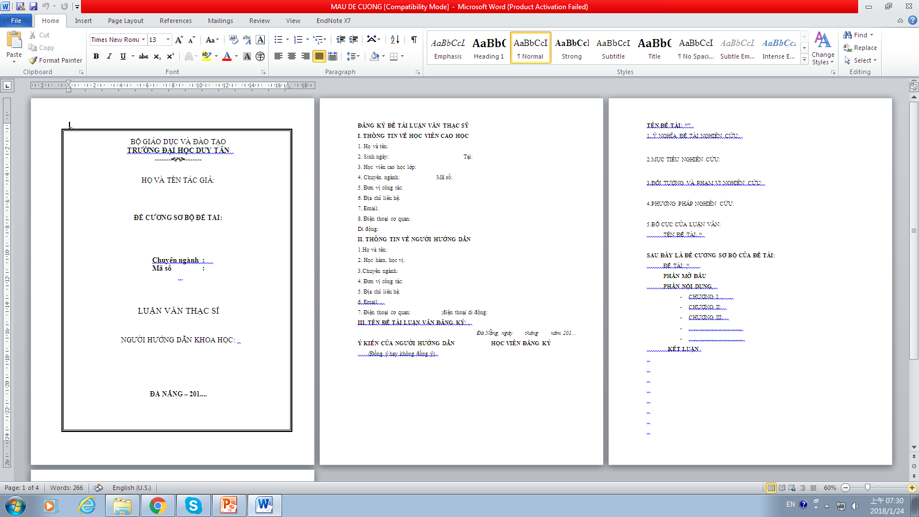
Forms - Procedures

Slide 15
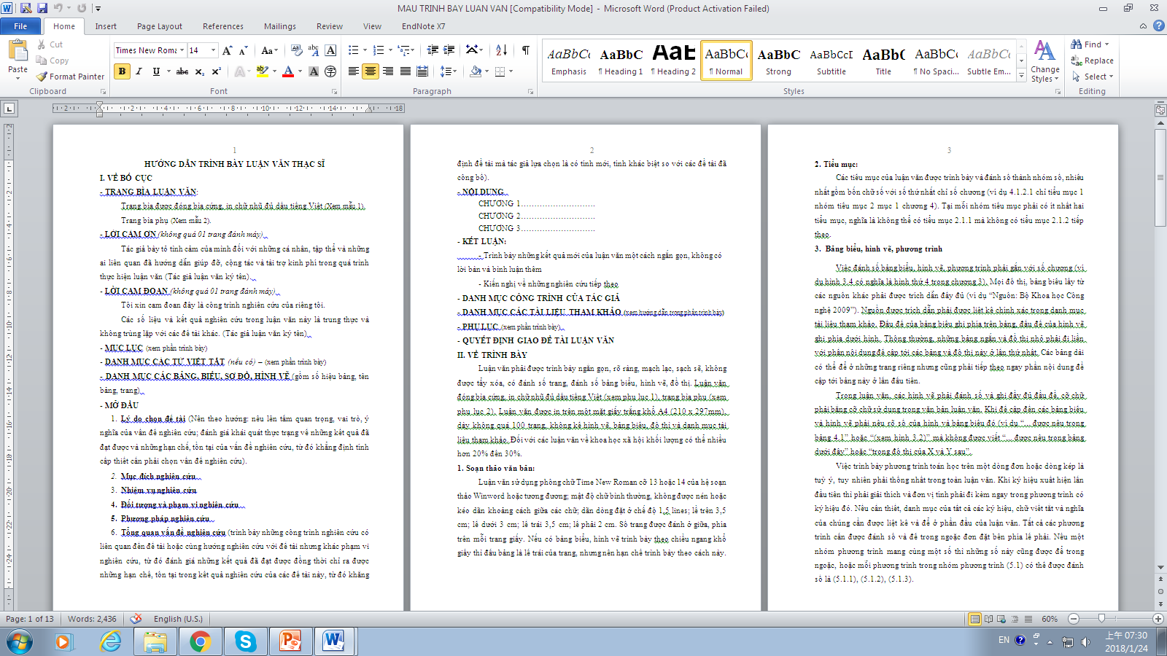
Forms - Procedures

Slide 16
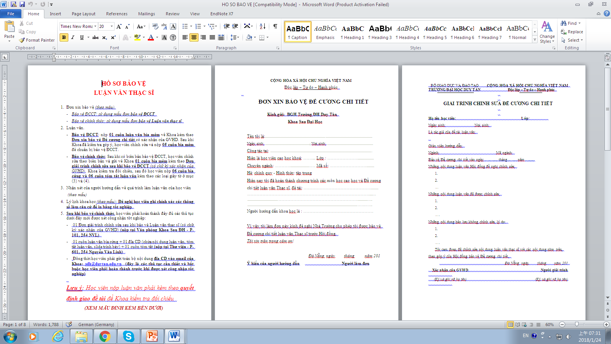
Forms - Procedures

Slide 17

Why do we need to publish?

Slide 18

Why do we need to publish?

Slide 19

Why do we need to publish?

Slide 20


Why do we need to publish?

Slide 21

Why do we need to publish?

Slide 22
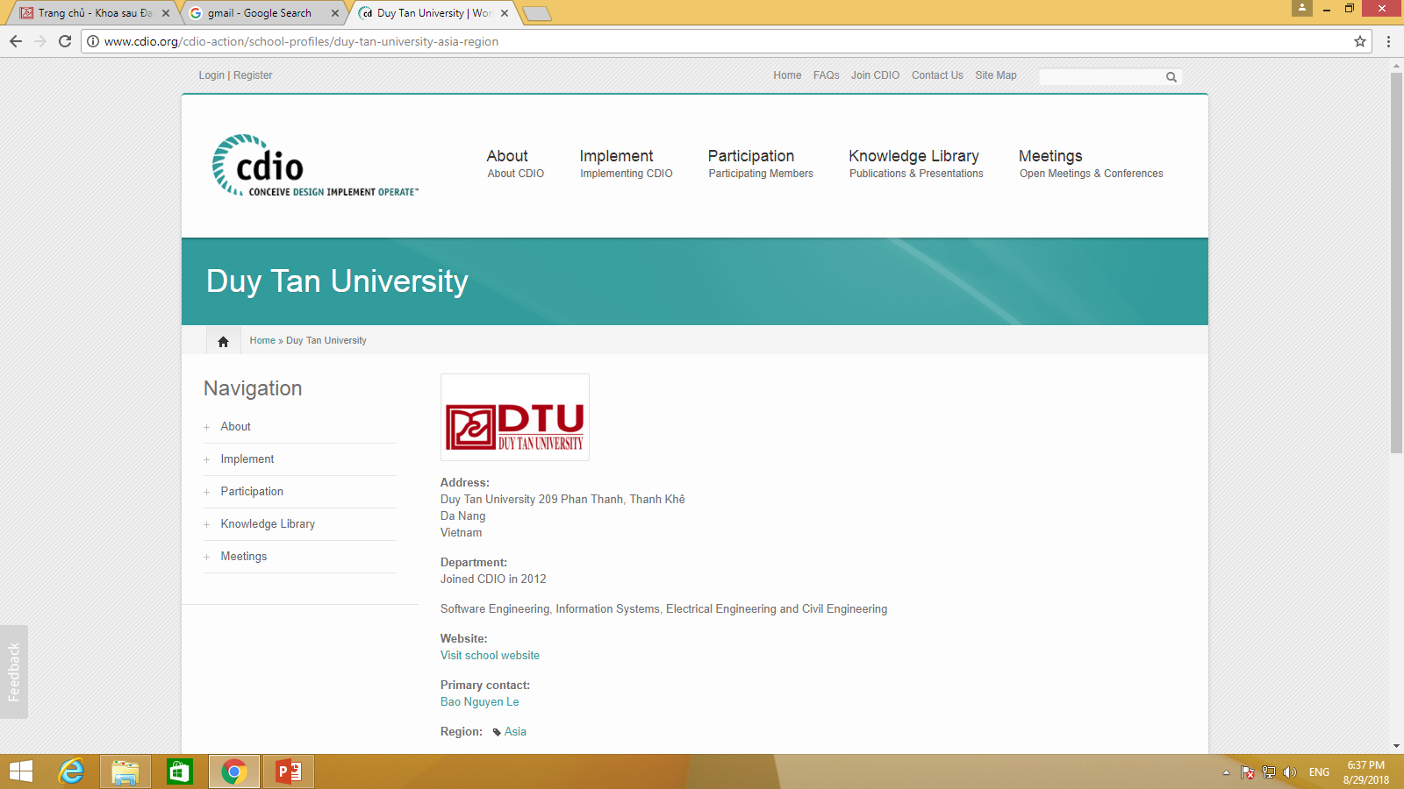

Slide 23
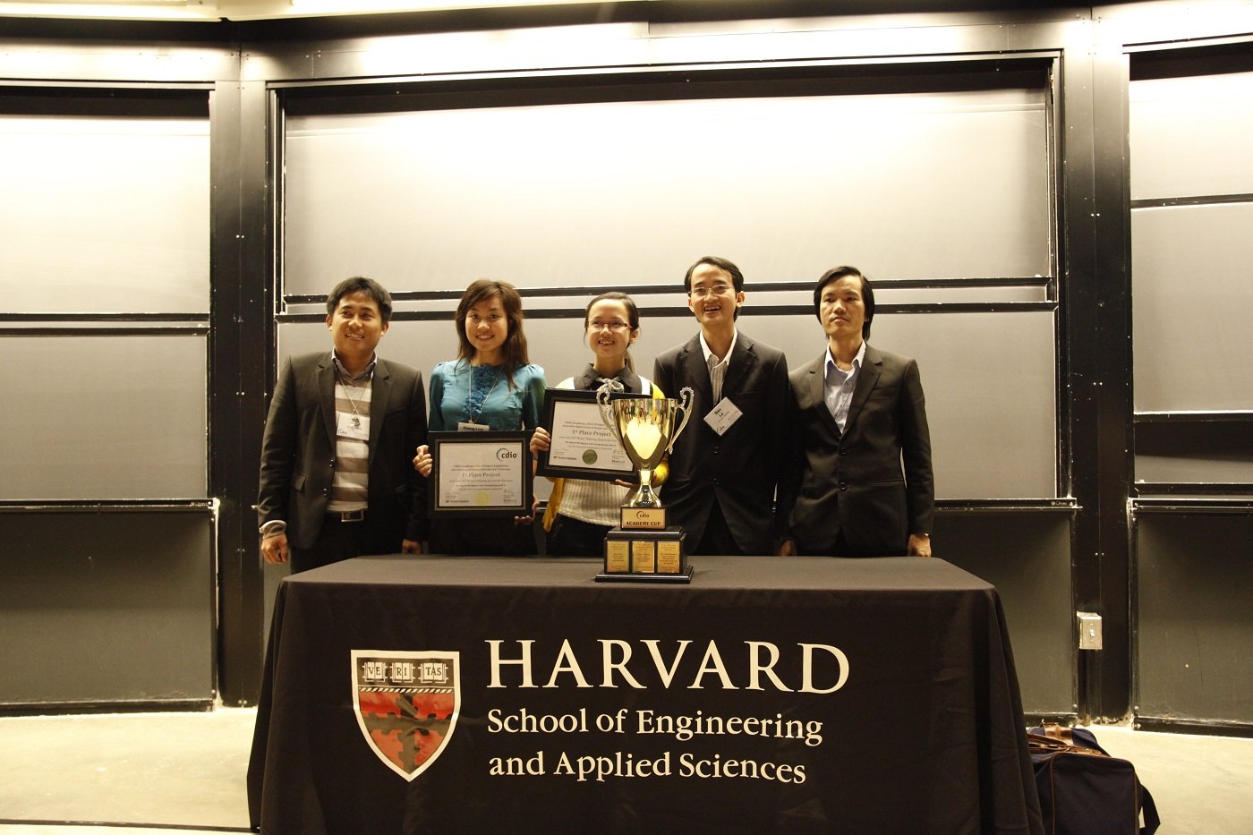
CDIO

Slide 24
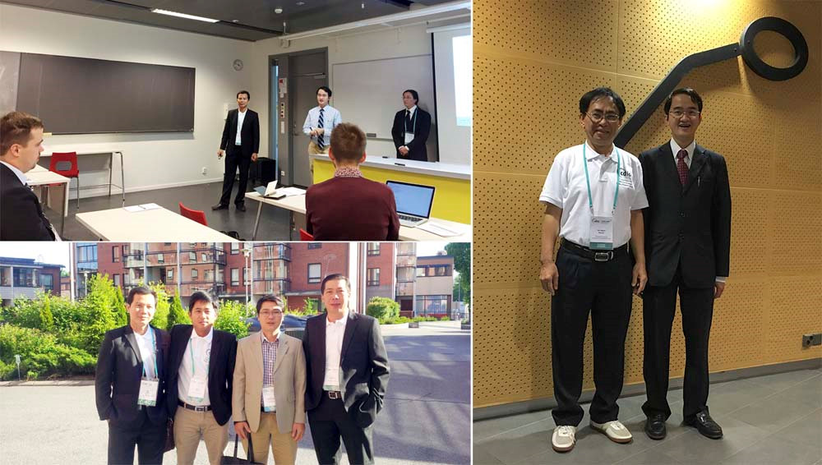
CDIO

Slide 25
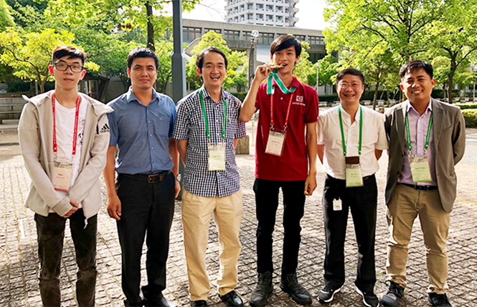
CDIO

Slide 26
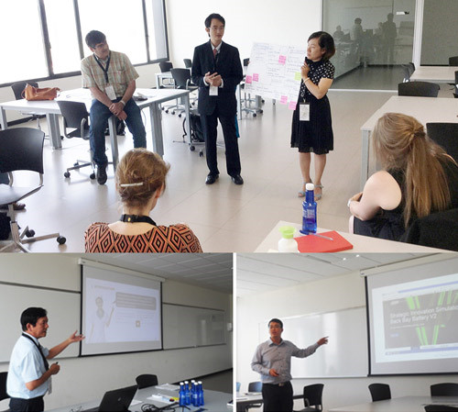
PBL

Slide 27
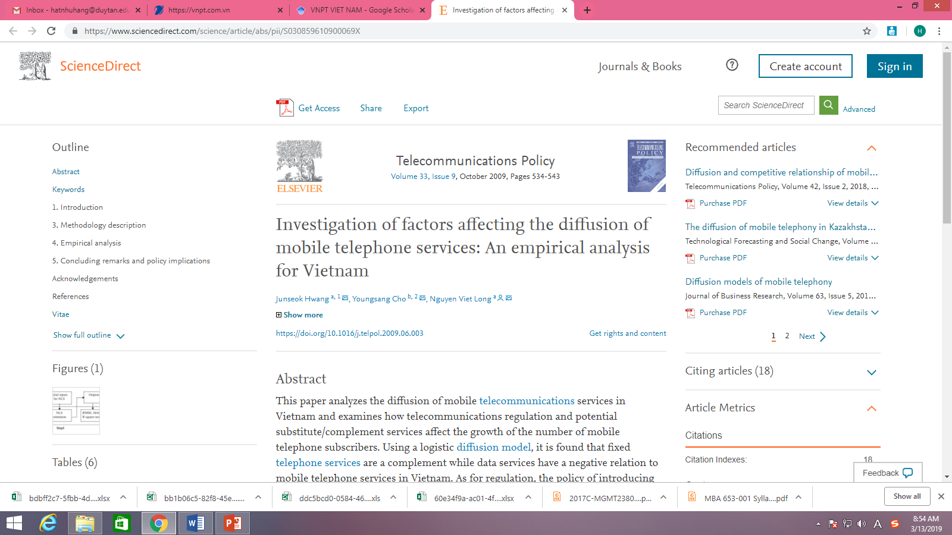

Slide 28
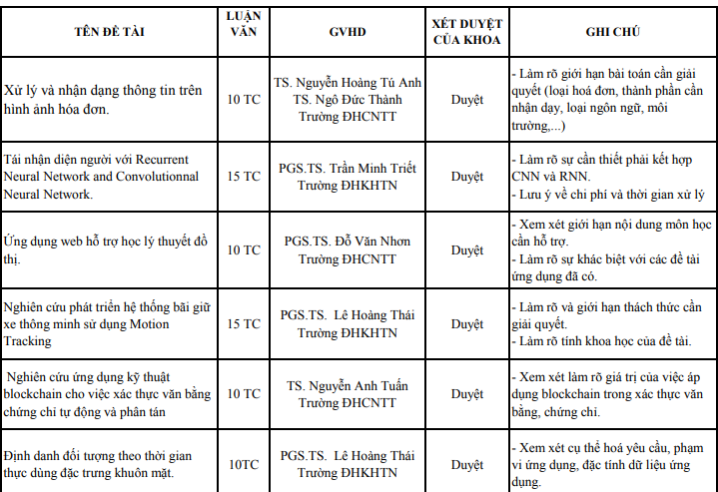

Slide 29
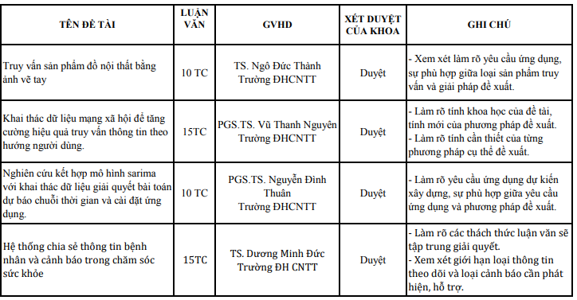

Slide 30
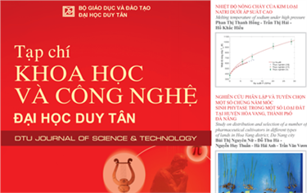

Slide 31

Process to get the goal
Findings
Data analysis
Take courses
Data collection
Literature Review
Topic

Slide 32
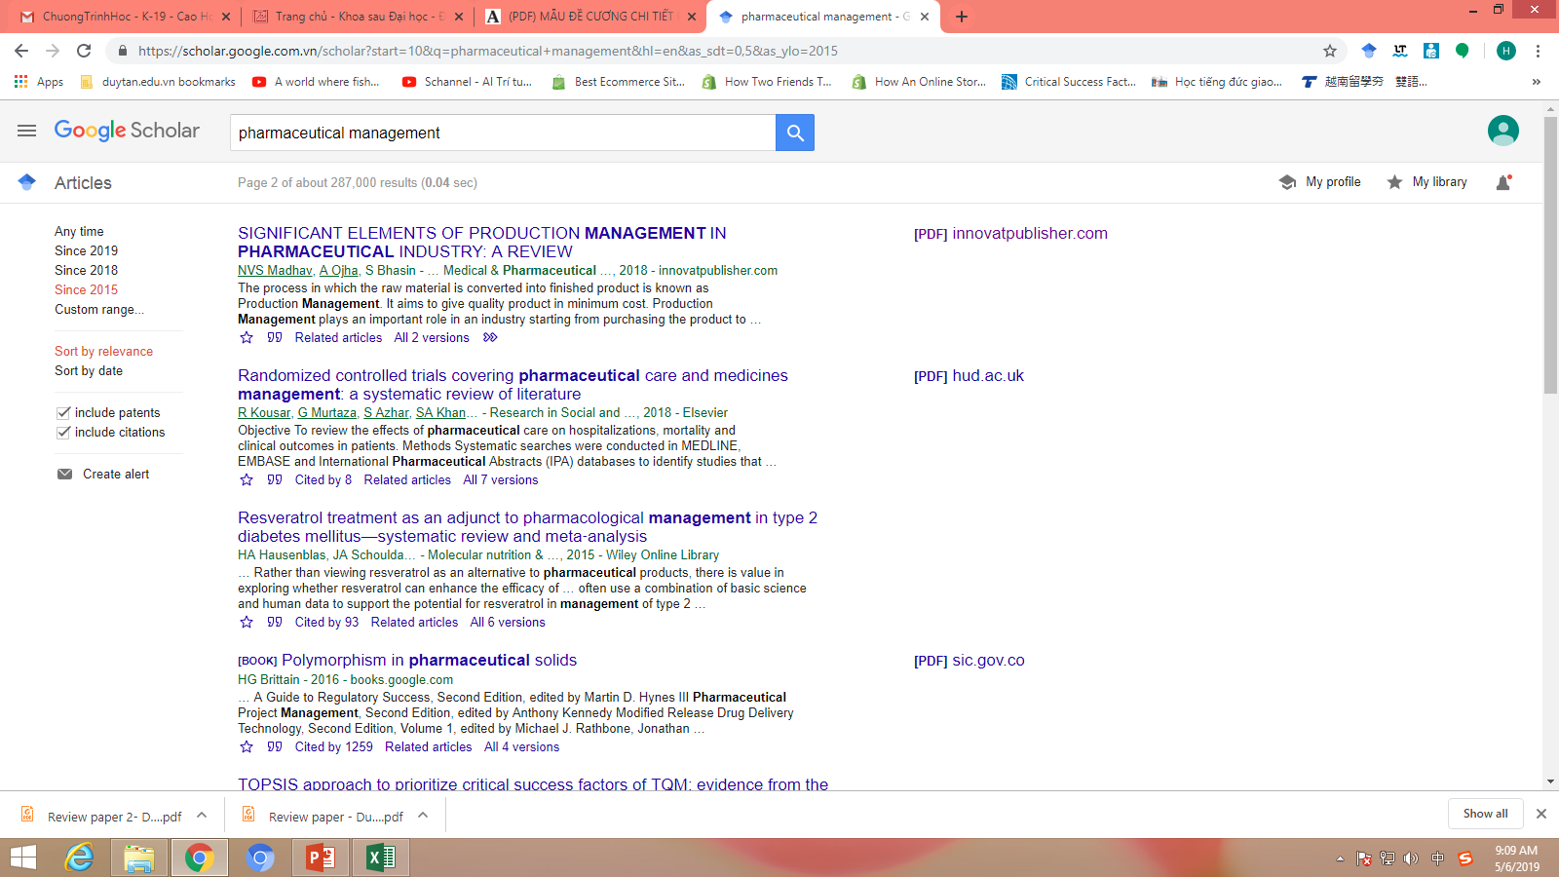

Slide 33
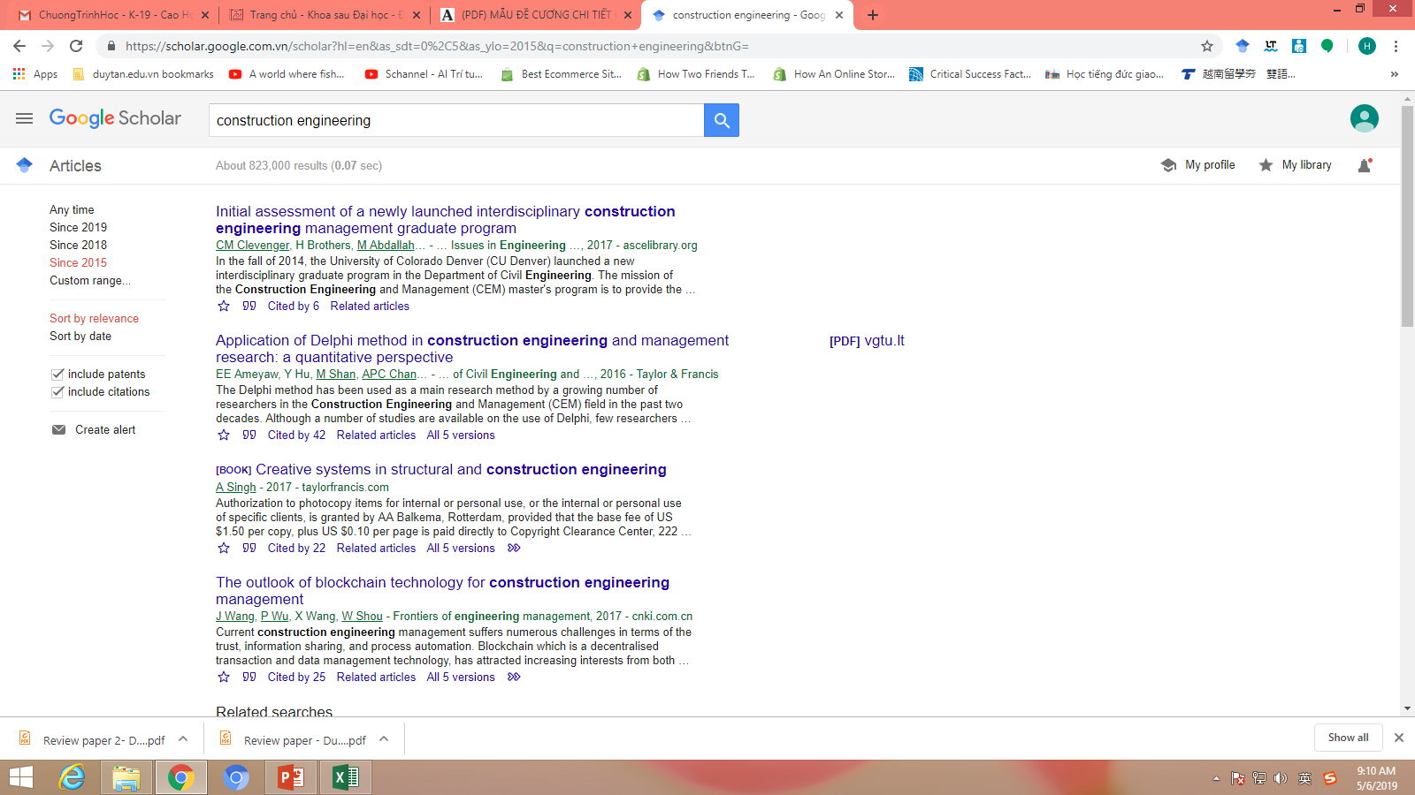

Slide 34
Chapter 1 Introduction to Research

Slide 35
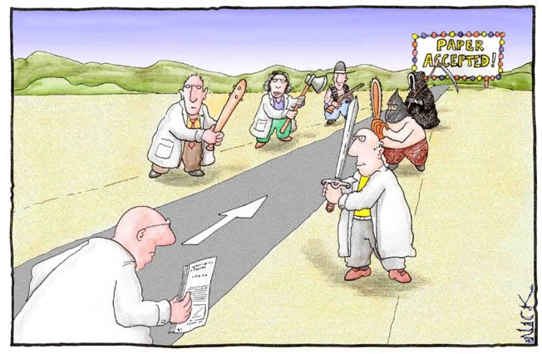
Your goal

Slide 36


Slide 37
Topic discussed
Definition of Research
Applied and Basic Research
Ethics and Business Research

Slide 38
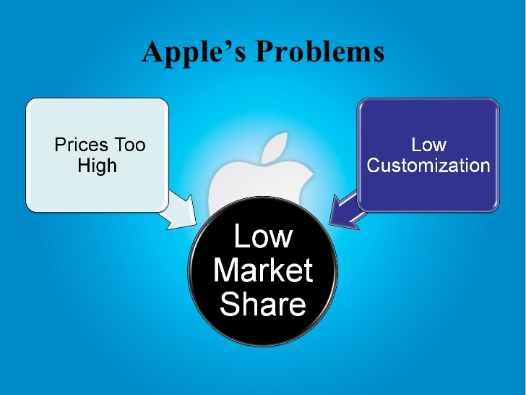
Problems

Slide 39
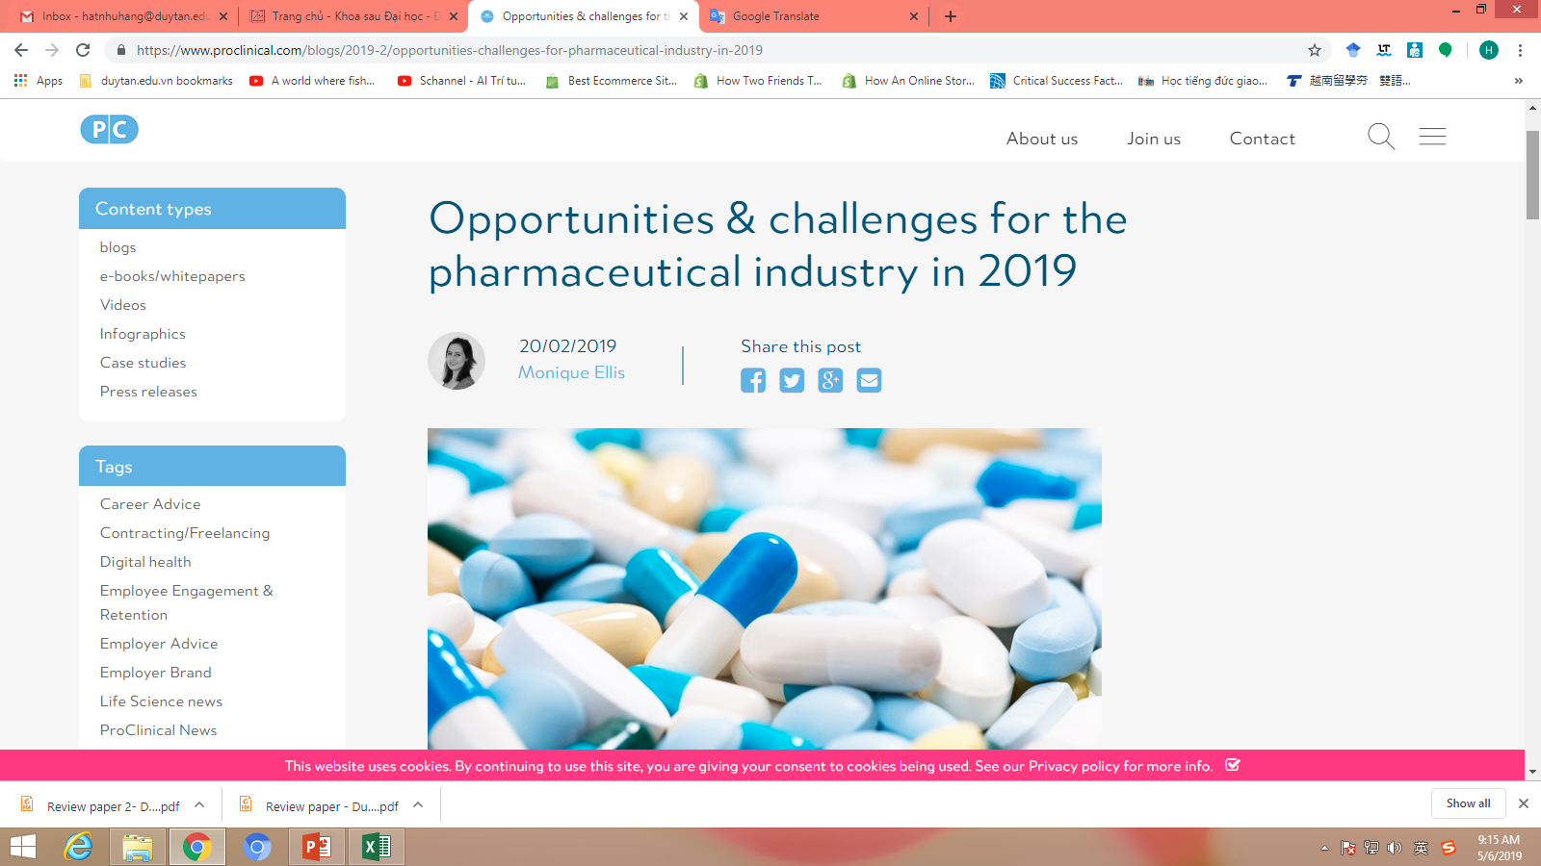
Problems
Slowed market growth
Patient-centric healthcare

Slide 40
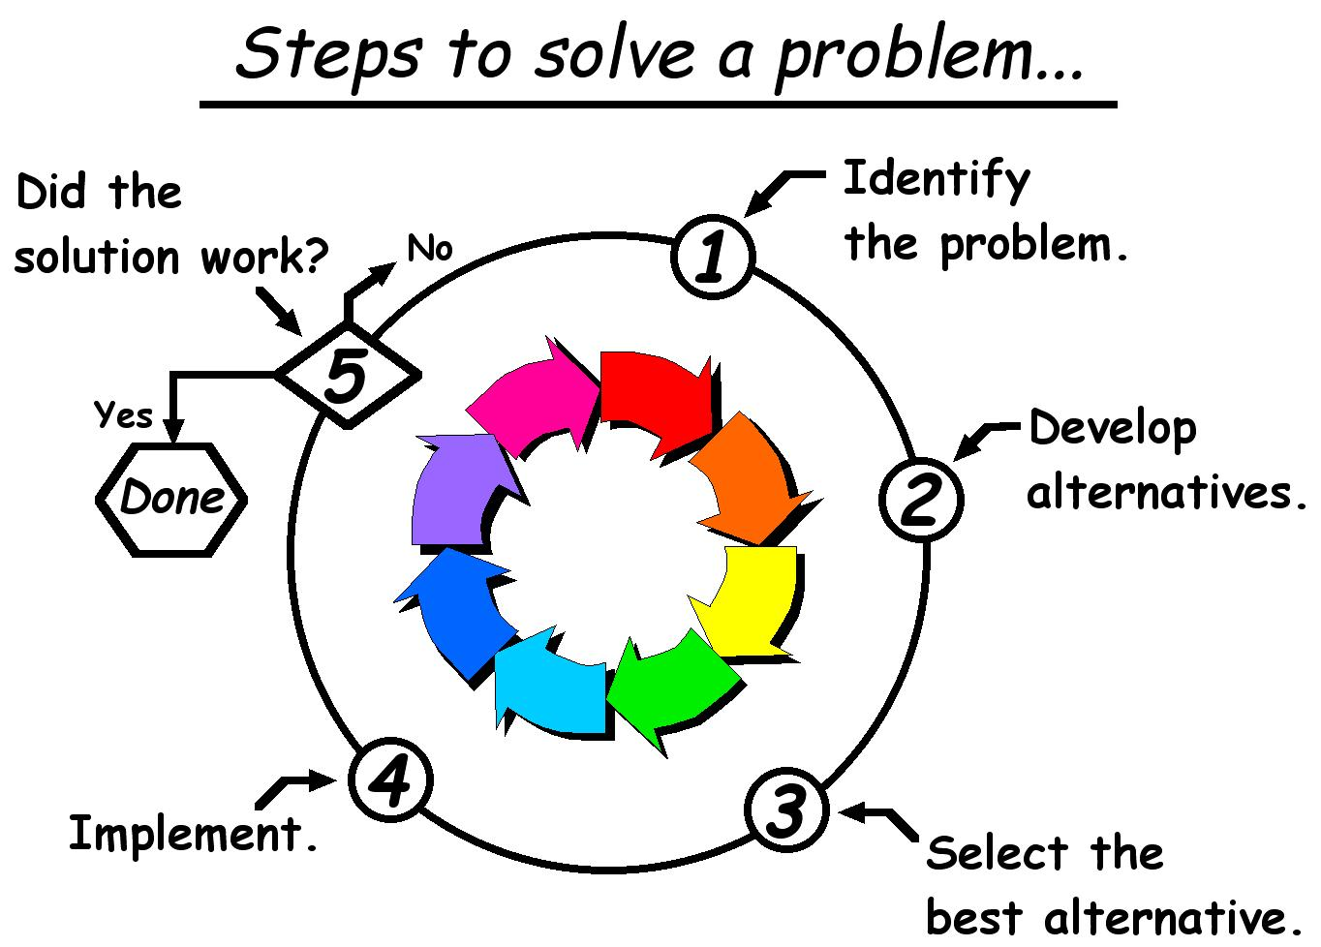

Slide 41
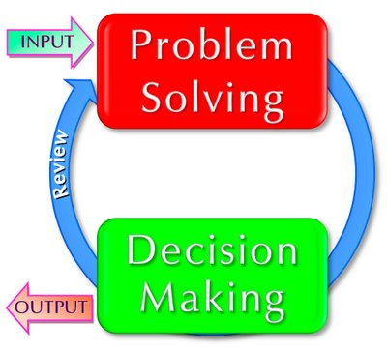
What is research?
Research is the process of finding solutions to a problem after a thorough study and analysis of the situational factors
Managers – studying, analyzing issues and making decisions at the workplace
Problems
Solutions

Slide 42
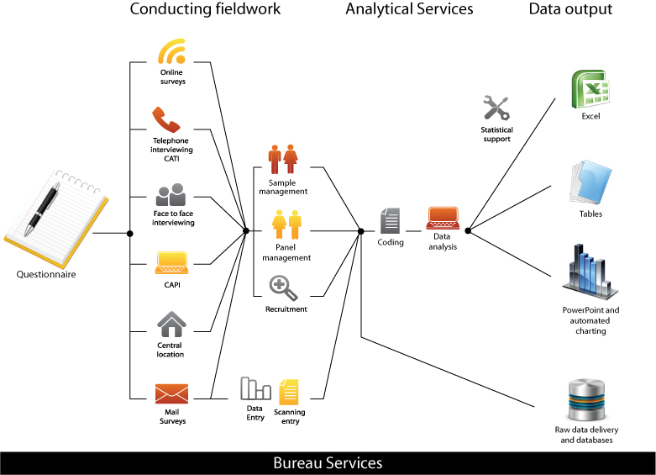
What is research?
http://www.ekas.com.au/process.html

Slide 43
What is research?
Manager makes decision
The difference between making good decisions and poor decisions, lies in how managers go about the decision-making process
Poor decisions
Good decisions

Slide 44
Applied and Basic Research
Types of Business Research
Applied research
To solve a current problem faced by the manager in the work setting
Basic research
To generate a body of knowledge about how to solve problems that could be occurred in organizations

Slide 45
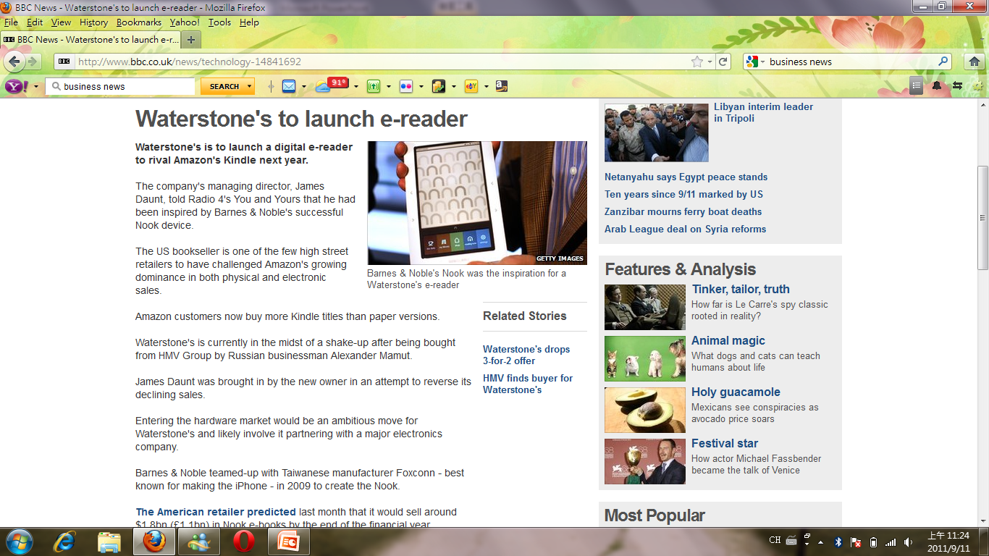
Examples of Applied Research

Slide 46
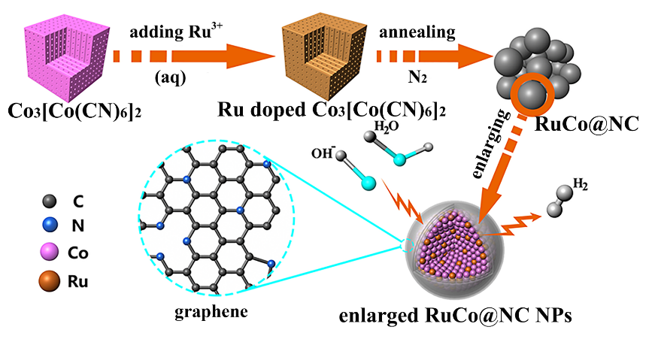
Examples of Basic Research
These findings later become useful for application in business situations

Slide 47
Basic and applied research (Saunders et al., 2007)
Applied research | Basic research
Improve understanding of specific organizational problems | Expand knowledge of organizational processes
Create solutions to organizational problems | Develop universal principles
Develop findings of practical relevance to organizational stakeholders | Produce findings of significance and value to society

Slide 48
Overview of the research process (Gill and Johnson, 2002)
Identify broad area for research
Select topic
Formulate research objectives
Decide approach
Formulate plan
Collect information
Analysis data
Present findings

Slide 49
Ethics and Business Research
Ethics in business research refers to a code of conduct of behavior while conducting research
Ethical conduct should also be reflected in the behavior of
Researchers who conduct the investigation
Participants who provide the data
Analysts who provide the results
Entire research team that presents the interpretation of the results and suggests alternative solutions

Slide 50
Thank you!

